Slide 1

Data Discovery, Assessment, and Planning of Deliverables
DnA IQ
2024

Slide 2
Table of Contents
Background and Vision
Current State
Future State
Recommendations
Roadmap

Slide 3




DnA IQ Data Architecture – Background & Vision
Opportunity for Improvement
Vision
Increased delivery velocity
Solidified conceptual data model to support multiple reporting needs
Avoid point to point solutions
Reduce number of Power BI Data Models
More predictable delivery milestones
Delivery roadmap
Enablement of DnA IQ team to develop in DnA IQ workspace
Requirement validation by Business
“Implement delivery model using a solidified data model and consistent deliverables to deliver phase 1 and future phases for NAOU Scorecard (RMS, Invoice, iRED) and PRX following a detailed delivery roadmap.”
Goals
Create conceptual data model for phase 1 of PRX and NAOU Scorecard
Complete phase 1 DMH and STM for the PRX and NAOU Scorecard
Create roadmap for complete delivery of PRX and NAOU Scorecard for 2024
Complete business review of conceptual data model
Expected Results
Conceptual Data Model, DMH, STM
Centralized DnA IQ data model
Roadmap
Data Engineering Handoff

Slide 4


Modern Data and Analytics Reference Architecture
Data Sources
Data Ingestion and Integration
Repositories
Data Provisioning
Digital Delivery
External Data
Raw Layer
Curated
Applications and Analytics
Visualization
Social Data
Web Browser
Block Storage
Enterprise Data Sets
Data Marts
Descriptive Analytics
Portal
Purchased
Data
Batch
Purpose Built
Predictive Analytics
Mobile
Real Time
Relational
Internal Data
Training Data
Sets
Prescriptive Analytics
Structured Transactional
Extract
Cloud Storage
Model Ready
Email
Machine Data
AI / ML
Data Quality
Unstructured Content
Enterprise Data
Discovery
Transform
Master Data
Master Data
Reference Data
Content
Self Service
Publish / Load
Operational
Scheduling
Scheduling
Monitoring and Alerts
Audit, Balance & Control
Data Governance and Architecture
Metadata Management
Data Quality
Data Security & Privacy
Model Management
Tools and Technology
Technology Governance
Program Governance
Architecture Governance
Infrastructure and Systems Management
Storage Management
Compute Management
Virtual Machines
Containers

Slide 5



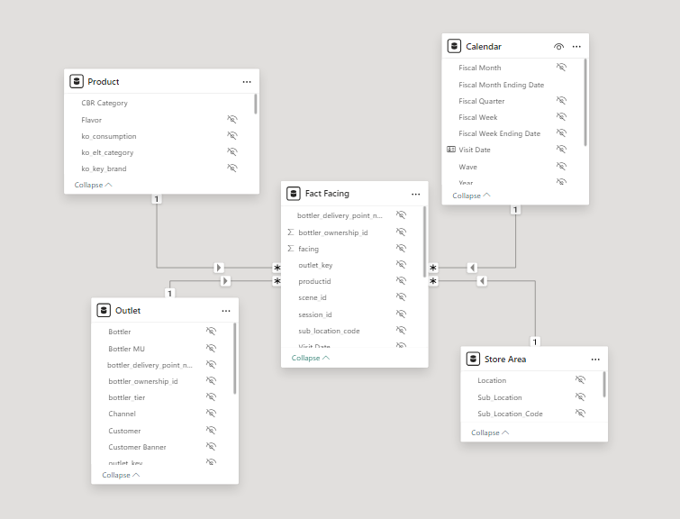
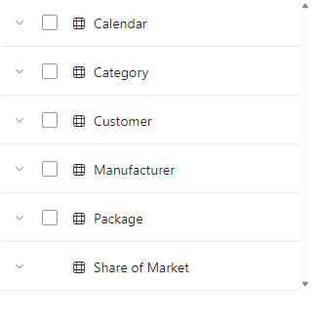


Current State Architecture
Data Sources
Data Ingestion and Integration (Extract, Transform and Load)
Repositories
Data Provisioning
Business Users
Current Sources (SSDP)
Nielsen RMS
CBS Invoices
SSDP
Pre-Gold (Structure)
Gold
Analytic
iRED
Beach, Numerator
Commercial
NAOU SSDP Ingestion Engine
Future Sources (SSDP)
Regional SSDP Ingestion/Lakehouse
NAOU Data Product Workspace – DnA IQ
IRED Explorer/RMS Scorecard
Franchise
Plus
FinHub(Rex/BPC)
Executive Leadership Team
Facings
Delivery
Curio DSD
SAP P28, P29, P30, P31
Share of Inventory (iRED)
Bottlers
Walmart Illuminate
Crest
Comp. Feature and Display Dollars
Web Browser (PBI)
Competitive Share of Market (RMS)
Retail Sales
TPM
eRed
Comp. Promo Dollars
Mobile (PBI)
Strategy
CDE Excel Cona
My Coke
Invoice (CBS)
Email (PBI)
Comp Dollars
Manual Inputs
Invoice AMT
prx_nielsen_market, ir_nielsen_prod_map
nielsen_ko_calendar, ir_location_map
nielsen_custhier_manual, bottler_branch_*
ielsen_bottlerhier_manual,
lmp_rate_table, dimLocalMarketProgram
irDoorlevelFacingConfig, dim_bottler_tier
ir_session_qc_list, dimCreditReportType
Manual Reference data
Operational
Manual Deployment and Monitoring
Data Governance and Architecture
Power BI
Tools and Technology
Infrastructure and Systems Management

Slide 6
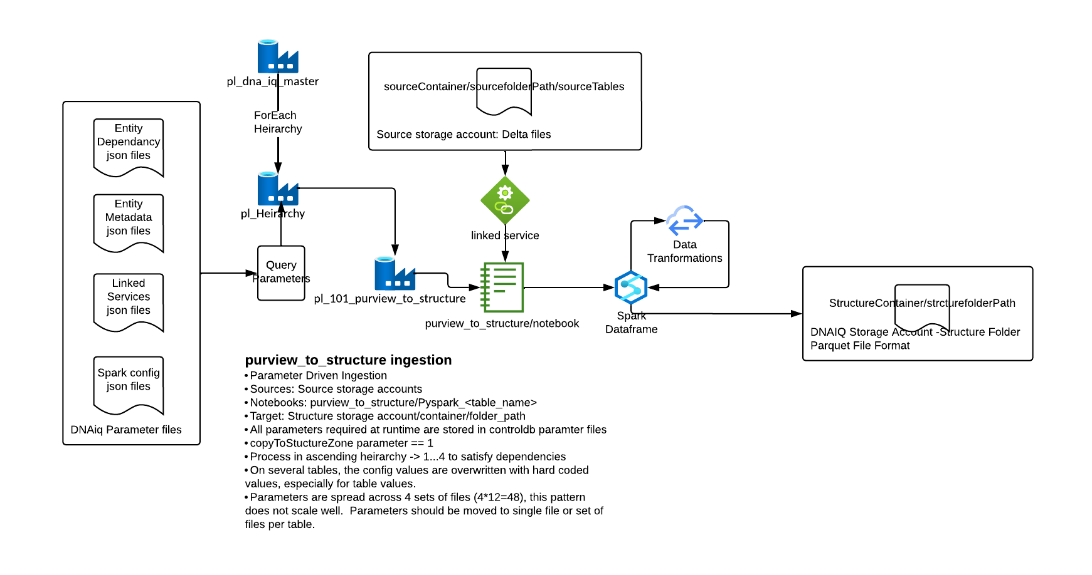
Current State 1.0 Framework Structure

Slide 7
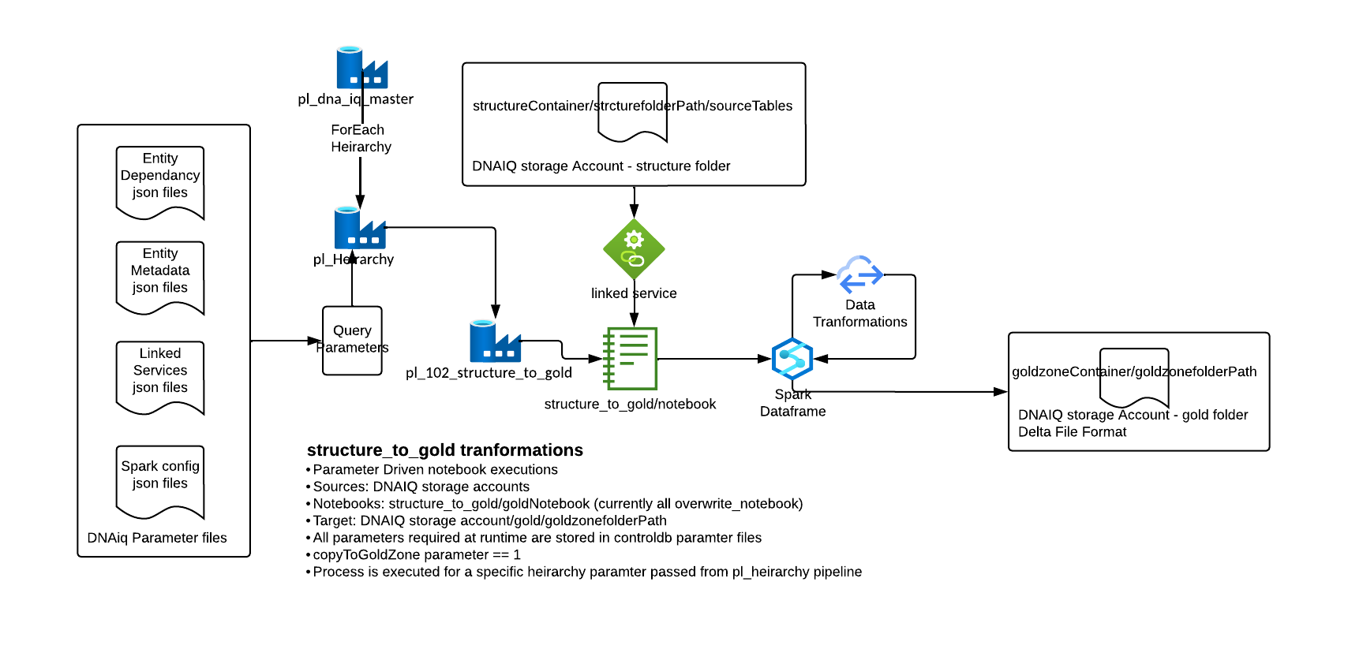
Current State 1.0 Framework Gold

Slide 8
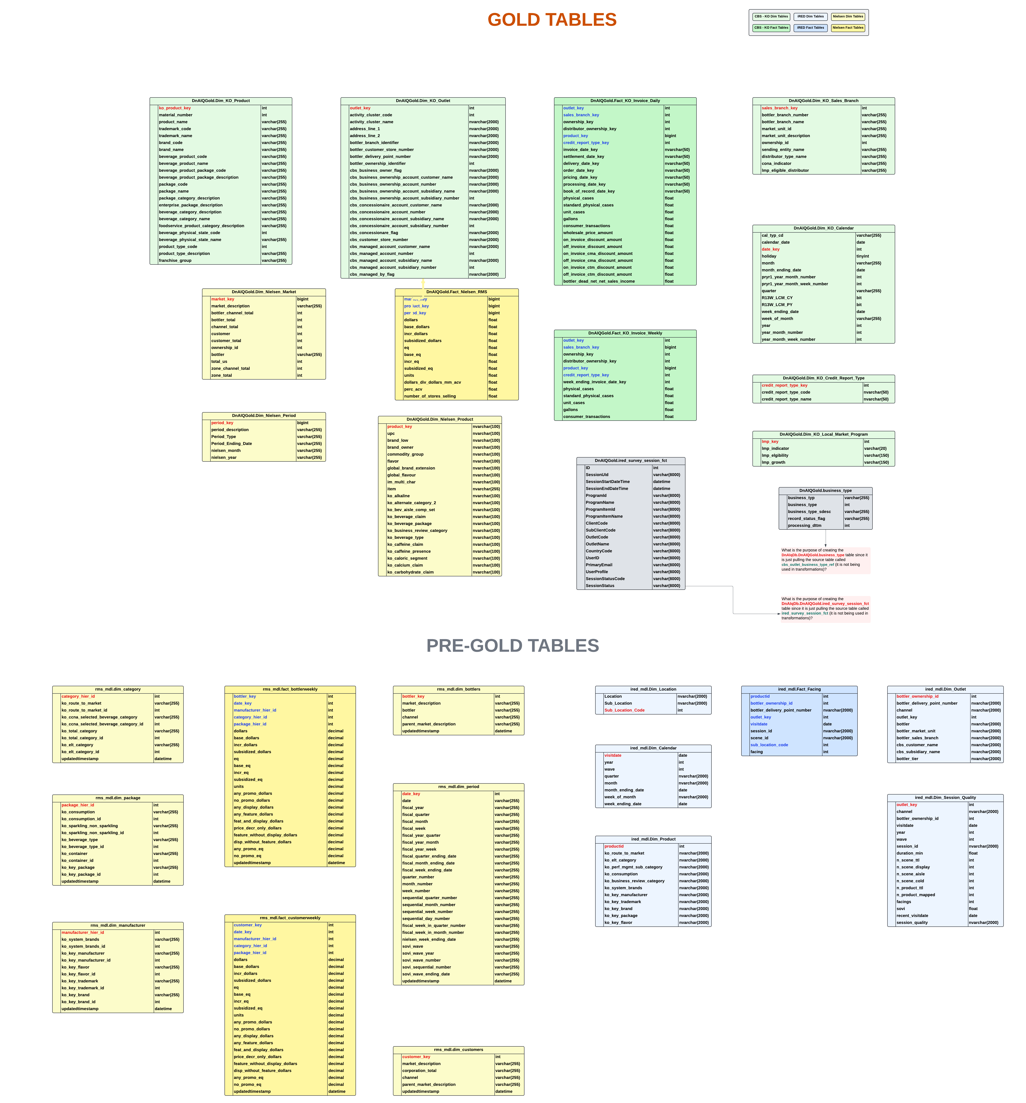
Current State Model
27 Modeled Entities for DnAIQ Data Product
Across two different schemas
No conformed dimensions
Source specific facts and dimensions
3 disparate power bi models
No ability to drill across data subject areas
Manual data loading process

Slide 9






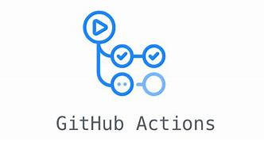
Future State Architecture
Data Sources
Data Ingestion and Integration (Extract, Transform and Load)
Repositories
Data Provisioning
Business Users
Current Sources (SSDP)
SSDP
Structured
Gold / Semantic
Nielsen RMS
CBS Invoices
Analytic
iRED
Beach, Numerator
Regional SSDP Ingestion/Lakehouse
Commercial
NAOU SSDP Ingestion Engine
NAOU Data Product Workspace – DnA IQ
NAOU Data Product Workspace – – DnA IQ
Future Sources (SSDP)
Master and Reference
Customer
KO Bottler
KO Product
KO Calendar
KO Outlet
Sales Branch
Measures
Availability %
Avg. # of Displays
Avg. # of Facings
Product Sales
Product Volume
Blended Measures
SOVI:SOM Ratio (Value & Volume EQ)
Franchise
Plus
FinHub(Rex/BPC)
Share of Inventory
Executive Leadership Team
Curio DSD
SAP P28, P29, P30, P31
Delivery
Competitive Share of Market
Bottlers
Walmart Illuminate
Crest
Web Browser (PBI)
Retail Sales
TPM
eRed
Invoice
Transactional Data
Facings
Competitive Sales Data
Coke Invoices
Mobile (PBI)
Strategy
CDE Excel Cona
My Coke
Email (PBI)
Manual Inputs
prx_nielsen_market, ir_nielsen_prod_map
nielsen_ko_calendar, ir_location_map
nielsen_custhier_manual, bottler_branch_*
ielsen_bottlerhier_manual,
lmp_rate_table, dimLocalMarketProgram
irDoorlevelFacingConfig, dim_bottler_tier
ir_session_qc_list, dimCreditReportType
Consolidated DnA IQ
Self Service
Operational
Data Governance and Architecture
Tools and Technology
Infrastructure and Systems Management

Slide 10
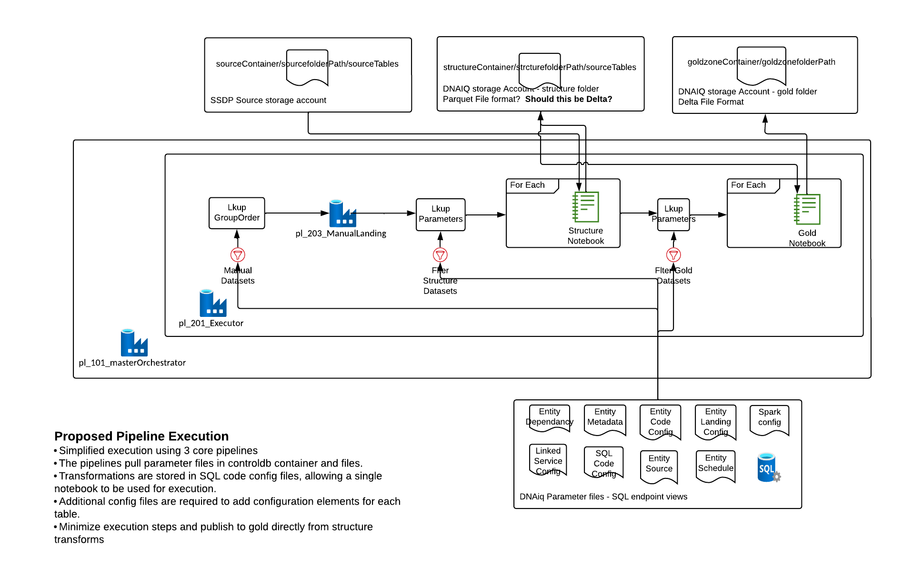
Future State 2.0 Framework

Slide 11
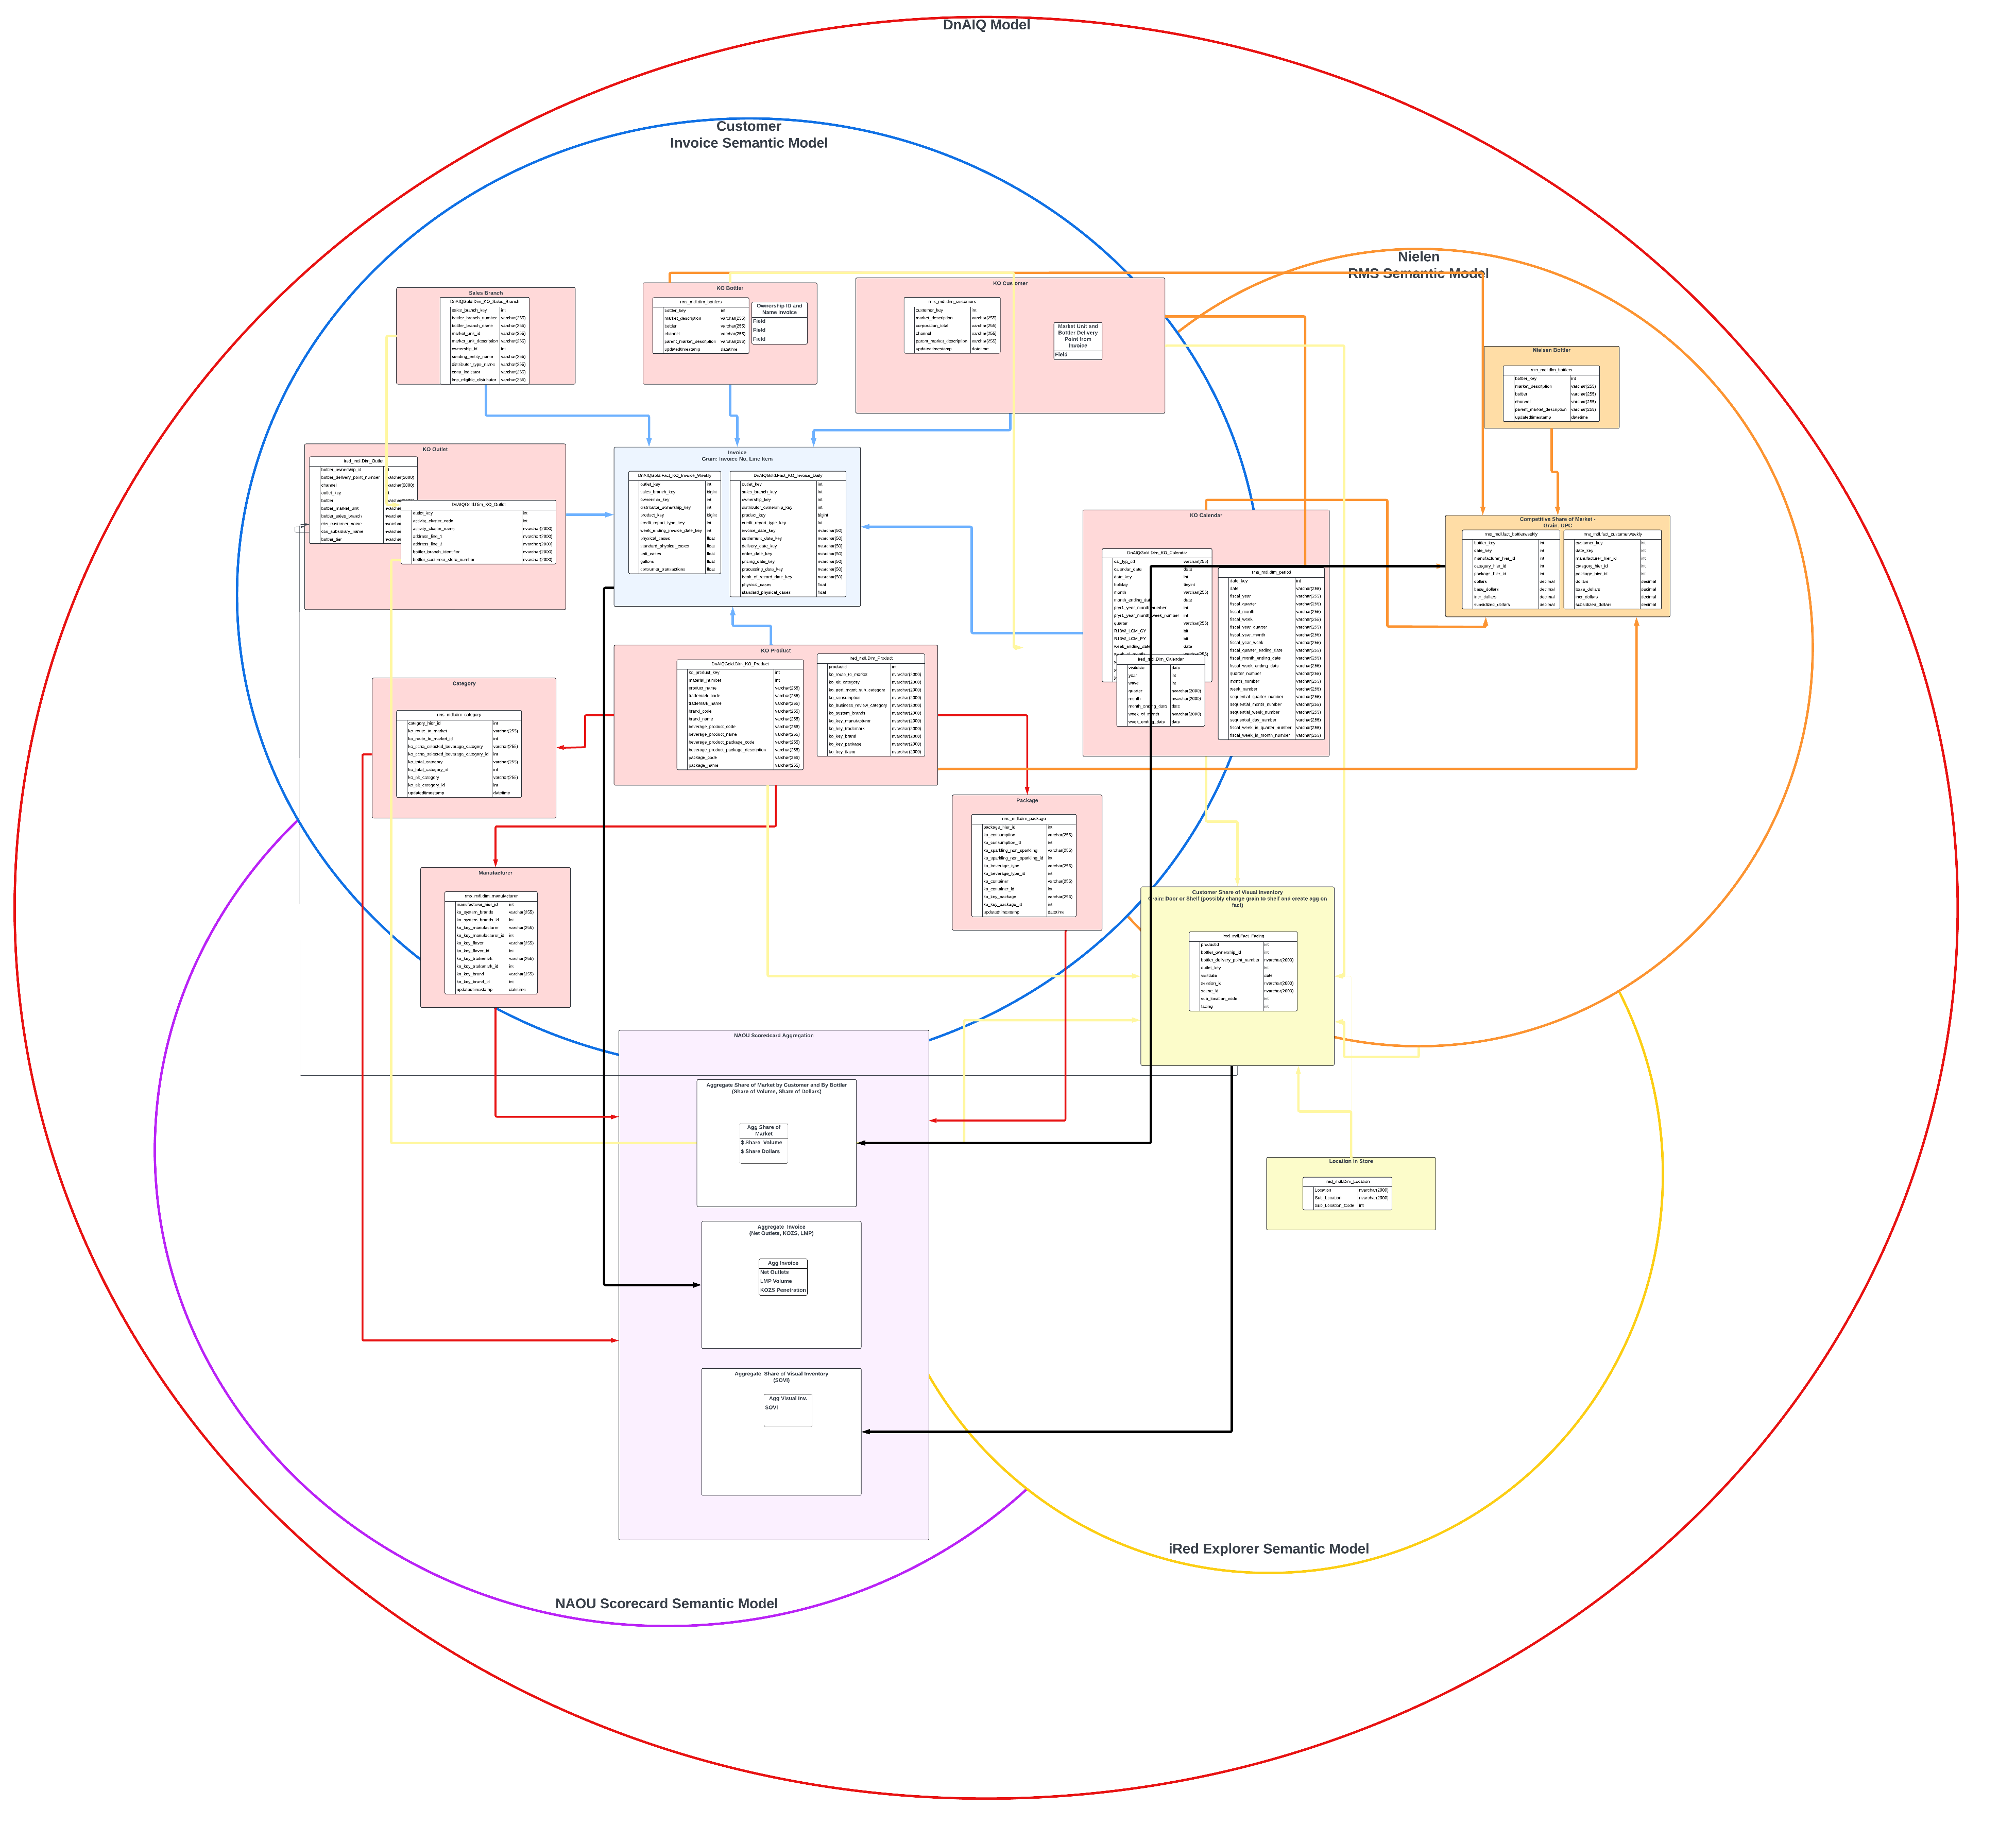
Future State Conceptual Model
18 Modeled Entities for DnAIQ Data Product
Aligns Customer Share of Visual Inventory (iRED), Coke Invoice (CBS), and Competitive Share of Market (RMS) data through 9 conformed dimensions
Reduces source specific facts and dimensions
Backbone for NAOU scorecard, PRX, and other initiatives
Will start with support of 5 Power BI Models (iRed Explorer, Nielsen RMS, Customer Invoice, PRX, NAOU Scorecard) on one Data Product Semantic Model
Enables automation of data loading process
Enables drill across subject areas to detail

Slide 12
Recommendations
Suggestion | Outcome
Move to new 2.0 Framework ASAP and away from dual architecture (Pre-Gold & 1.0 Framework) | Increased development velocity and standard development practices for the team to create consistency and automation
Release first three milestones from Pre-Gold with manual monitoring and execution by team | Increased capacity to move to new Framework and ingestion requirements while continuing business engagement
Adopt suggested enterprise conceptual data model for DnAIQ | Single source of truth and ability to conduct diagnostic analytics and drill across subject areas
Spend resources and time ASAP on pre-work for new 12 ingestion data sets needed for future 7Cs and NAOU Scorecard | Ability to deliver category profitability and NAOU scorecard as dev complete and test begin by EOY

Slide 13

 | Q2 |  |  |  | Q3 |  |  |  | Q4
Initiative | Sprint 53 | Sprint 54 | Sprint 55 | Sprint 56 | Sprint 57 | Sprint 58 | Sprint 59 | Sprint 60 | Sprint 61 | Sprint 62 | Sprint 63 | Sprint 64 & 65
Implement Data Product Framework
Priority 1 &2 Sources
Priority 3 Sources
Priority 4 & 5 Sources
Competition (RMS)
Category Profit (Invoice*)
Customer (iRED)
Category Profit V2
Channel Footprint
Consumer Future
NAOU Scorecard
NAOU Scorecard/Semantic
PRX Scorecard/Semantic
IRED Explorer/Semantic
Initial Load, Incremental Load, SIT, & UAT Support
UAT
Framework
Framework
Ingestion
Pre-Work
Dev
QA Testing;
Future Delivery
Pre-Work
Dev
Dev
QA Testing;
Pre-Work
Dev
QA Testing;
Current Delivery
Analytics
Physical Model and Update STM
Build Structure
Build Gold
Physical Model and Update STM
Build Structure
Build Gold
Physical Model and Update STM
Build Structure
Build Gold
Physical Model and Update STM
Build Struct.
Build Gold
Update Model and STM
Physical Model and Update STM
Build Struct.
Build Gold
Update Model and STM
Physical Model and Update STM
Build Struct.
Build Gold
Update Model and STM
Physical Model and Update STM
Build Structure
Build Gold
Build Struct.
Build Gold
Viz
Build v1
Build v2
Build v1
Category Profitability Dev Complete
Build v2
Testing
Manual Pre-Gold/Old Framework
6 Weeks
5 Weeks
UAT
UAT
Milestones
Competition V1
IRed Explorer
Customer Execution V1
NAOU SC Core Dev Complete
NAOU Scorecard V1
NAOU Core Dev V2
NAOU Feb. 1 Go-Live

Slide 14
 | Q2
Initiative | Sprint 53 | Sprint 54 | Sprint 55 | Sprint 56
Implement Data Product Framework
Plus (P1)
Curio DSD (Renaissance Aggregate Views) (P2)
Walmart Illuminate (P2)
TPM (Renaissance Aggregate Views) (P3)
CDE Excel Cona (P3)
FinHub(Rex/BPC) (P3)
SAP P28, P29, P30, P31 (P4)
Crest (P4)
Beach (P4)
eRed (P4)
MyCoke (P4)
Numerator (P5)
Competition
Category Profit
Customer
Framework
DNaIQ Data Product Framework
Ingestion
SSDP Ingestion Pre-Work
Ingestion Development
SSDP Ingestion Pre-Work
Ingestion Development
SSDP Ingestion Pre-Work
Ingestion Development
SSDP Ingestion Pre-Work
Ingestion Development
SSDP Ingestion Pre-Work
Ingestion Development
SSDP Ingestion Pre-Work
Ingestion Development
SSDP Ingestion Pre-Work
SSDP Ingestion Pre-Work
SSDP Ingestion Pre-Work
SSDP Ingestion Pre-Work
SSDP Ingestion Pre-Work
SSDP Ingestion Pre-Work
Analytics
Physical Model and Update STM
Build Structure
Build Gold
Physical Model and Update STM
Build Structure
Build Gold
Physical Model and Update STM
Build Structure
Build Gold

Slide 15
 | Q3
Initiative | Sprint 57 | Sprint 58 | Sprint 59 | Sprint 60
Plus
Curio DSD (Renaissance Aggregate Views)
Walmart Illuminate
Priority 3 Sources
Priority 4&5 Sources
Competition
Category Profit
Customer
Category Profit V2
Channel Footprint
Consumer Future
NAOU V2
NAOU V1
PRX V1
IRED Explorer V2
Initial Load, Incremental Load, SIT, & UAT Support (PRX /NAOU V1)
UAT (PRX /NAOU V1)
Ingestion
Ingestion QA Testing;
Ingestion QA Testing
Ingestion QA Testing
Ingestion Development
Ingestion QA Testing;
Ingestion Development
Ingestion QATesting
Analytics
Build Gold
Build Gold
Build Gold
Physical Model and Update STM
Build Structure
Build Gold
Physical Model and Update STM
Build Structure
Build Gold
Physical Model and Update STM
Build Structure
Build Gold
Build Structure
Build Gold
Visualization
Build
Build
Build
Testing
6 Weeks
UAT

Slide 16
 | Q4
Initiative | Sprint 61 | Sprint 62 | Sprint 63 | Sprint 64-65
QA Testing
NAOU Scorecard Analytics V2
Category Profit Analytics V3
Channel Analytics V3
Consumer V3
NAOU Scorecard V2
PRX V2
IRED Explorer V2
Initial Load, Incremental Load, SIT, & UAT Support NAOU V2
UAT
Operations Support & KT
Ingestion
Ingestion QA Testing
Analytics
Build Gold
Physical Model and Update STM
Physical Model and Update STM
Physical Model and Update STM
Visualization
Build Dashboard
Build Dashboard
Build Dashboard
Testing
5 Weeks
UAT
NAOU Scorecard V1 3 Weeks

